Slide 1
Data Structures using c
UNIT 1
BY. DEEPTI CHAUDHARI

Slide 2
CONTENTS
Data
Data types
Data Structure
Abstract Data Type(ADT)
Characteristics of Algorithm
Analyzing Program

Slide 3
1. Data
Data is the basic fact or entity that is utilized in calculation or manipulation.
Data may be a single value or it may be a set of values
2. Data Types
Integer, float, char, string, double, long int

Slide 4
3. Data Structure
Data structure is representation of the logical relationship existing between individual elements of data.
Data structure mainly specifies
Organization of data
Accessing Methods
Degree of Associativity
Processing of alternatives for information

Slide 5
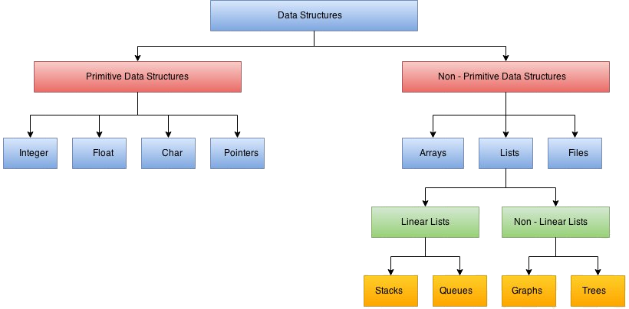
Classification of Data Structure

Slide 6
Non-Primitive Data Structures
The non-primitive data structures emphasize the structuring of a group of homogeneous or heterogeneous data items.
Example of Non-Primitive Data Structures
Arrays
Lists
Files
Stacks
Queues
Graphs
trees

Slide 7
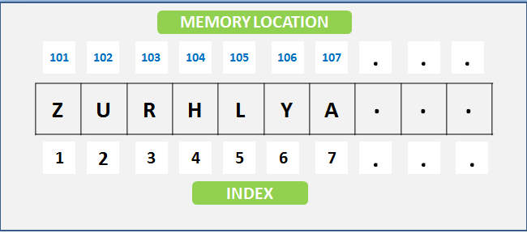
1. Arrays
An array is defined as it is a collection of items stored at contiguous memory locations. we can also say that arrays are the set of homogeneous data elements stored in RAM, therefore, it can hold only one type of data.

Slide 8
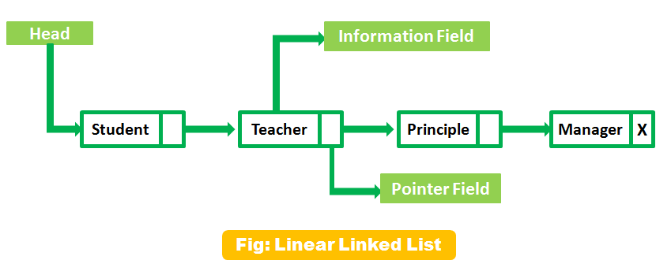
2. Lists
A Lists is defined as it is a collection of a variable number of data items. lists or sequence is an abstract data type, which always represents a countable number of ordered values, Every list element contains at least two fields, one field is used for storing the data and another filed is used for storing the address of the next element.

Slide 9
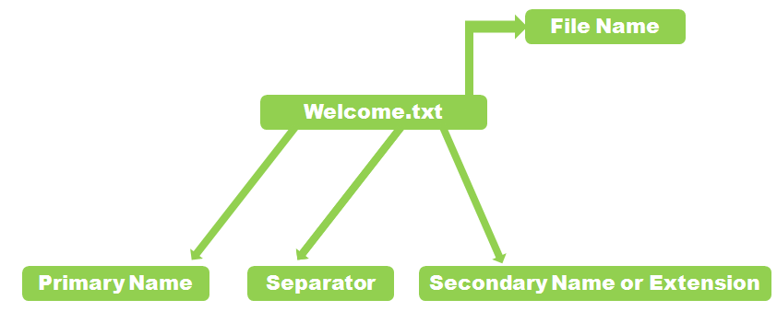
3. Files
Files contain information, and this information stored permanently in the Hard Disk and Floppy Disk, this disk also knows as a secondary storage device. you can store a little byte of data and a large amount of data in secondary devices.
therefore, A file name always contains the primary and secondary name and dot(.) is used for separating. for understanding in a better way see the below Diagram

Slide 10
4. Stack
A stack is a basic data structure, it’s defined as an ordered collection of elements represented by a real physical stack.
Liner data structure features insertion and deletion of items take place at one end called top of the stack.
Therefore, In these structure data set as a stack of books or plates, in the stack, you can remove the item from the top order. you can use these concepts or structures all throughout programming. the implementation of the stack also know as LIFO (Last in First Out)
these are the three basic concepts that can be performed on stacks. 1) push (insert the items into a stack) 2) Pop (delete an item from the stack)

Slide 11
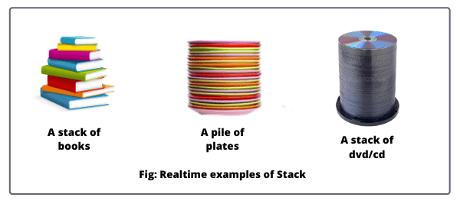
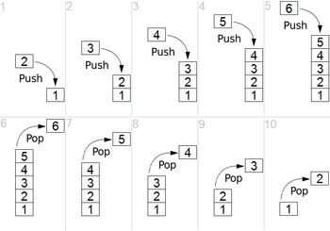

Slide 12
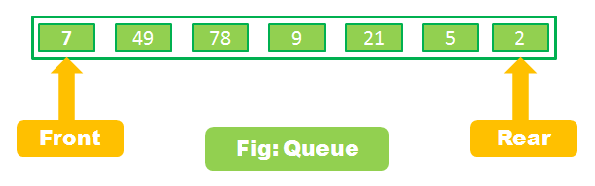
5. Queue
Queue defined (FIFO) First In First Out type of data structure. Queues are also the part of non-primitive linear data structure, therefore in Queues process, we can insert an element in a queue from the REAR end and delete an element from the FRONT end only.
Therefore, Implement queues with using two ways:
Pointers
Arrays

Slide 13
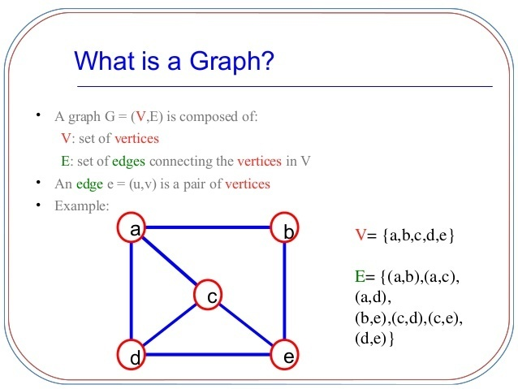
6. Graphs
There are different types of graphs :
Connected Graph
Non-Connected Graph
Directed Graph
Non-Directed Graph
therefore, graphs are the non-linear and non-primitive type of data structure. graph is representing the different types of physical design structures.

Slide 14
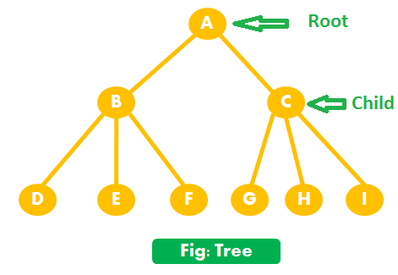
7. Trees
In the classification of data structure, Trees also come in the non-primitive and non-linear category data structure, using tree we can represent a hierarchical relationship between the data elements.

Slide 15
Data Structure the most commonly used operations
As a result, in the Classification of Data Structure, Data Structure the most commonly used operations are broadly categorized into four types: (1) Create (2) Delete (3) Selection (4) Update
CREATE operation
The CREATE operation (it can be defined) results in reserving memory for the program elements. This can be done by a declaration statement. The creation of data structure may take place either during compile -time or during Runtime.
DELETE operation
therefore, on the other hand, DELETE operation destroys the memory space allocated for the specified data structure Malloc() and free () as a result, the function of C language is used for these two operations respectively.

Slide 16
The SELECTION operation
The SELECTION operation can be defined as its deals with accessing particular data within a data structure. And the last operations UPDATE, as the name implies, it updates or modifies the data in the data structure. hence, in the Classification of Data Structure the operation Probably new data may be entered or previously stored data may be deleted.

Slide 17
Abstract Data Type(ADT)
Abstract Data type (ADT) is a type (or class) for objects whose behaviour is defined by a set of value and a set of operations.
The definition of ADT only mentions what operations are to be performed but not how these operations will be implemented. It does not specify how data will be organized in memory and what algorithms will be used for implementing the operations. It is called “abstract” because it gives an implementation-independent view. The process of providing only the essentials and hiding the details is known as abstraction.

Slide 18
Characteristics of Algorithm
Algorithm is a step-by-step procedure, which defines a set of instructions to be executed in a certain order to get the desired output. Algorithms are generally created independent of underlying languages, i.e. an algorithm can be implemented in more than one programming language.
An algorithm should have the following characteristics −
1.Unambiguous − Algorithm should be clear and unambiguous. Each of its steps (or phases), and their inputs/outputs should be clear and must lead to only one meaning.
2. Input − An algorithm should have 0 or more well-defined inputs.
3. Output − An algorithm should have 1 or more well-defined outputs, and should match the desired output.
4. Finiteness − Algorithms must terminate after a finite number of steps.
5.Feasibility − Should be feasible with the available resources.
6. Independent − An algorithm should have step-by-step directions, which should be independent of any programming code.

Slide 19
Problem − Design an algorithm to add two numbers and display the result.
Step 1 − START
Step 2 − declare three integers a, b & c
Step 3 − define values of a & b
Step 4 − add values of a & b
Step 5 − store output of step 4 to c
Step 6 − print c
Step 7 − STOP

Slide 20
programs
1 factorial of a number
Fibbonacci series generation
Reverse number (any digit 2,3,4)
Calculating power of number
Prime number checking

Slide 21
Fobbonacci series
0 1 1 2 3 5 8 13

